Slide 1

Measurement of the ²⁷Al(p,α)²⁴Mg reaction using the THM
Marco La Cognata

Slide 2
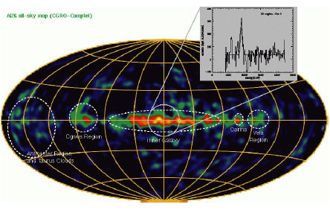
²⁷Al: an ingredient in multimessenger astronomy
MgAl cycle in massive stars
²⁶Al/²⁷Al abundance ratio
It is ignited at temperatures > 0.03 GK and it is important to determine the abundances of medium mass nuclei
²⁶Al abundance is used to estimate the number of Galactic neutron stars and, therefore, of neutron star mergers (sources of GW)
The ²⁶Al/²⁷Al is generally
estimated, so it is
influenced by ²⁷Al
abundance predictions

Slide 3
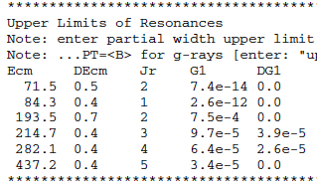
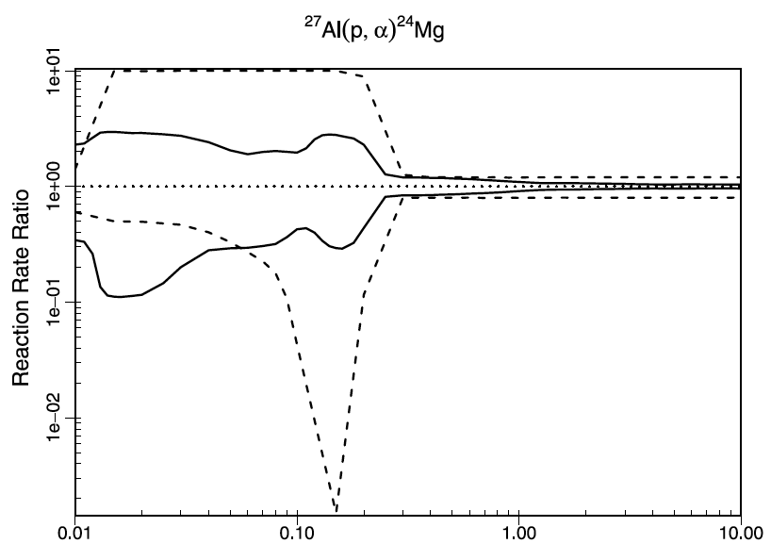
²⁷Al(p,α)²⁴Mg status of the art
The most recent review [Iliadis et al. (2010)] shows that for most low-energy resonances only an upper limit is known
→ These resonances are the most influent for astrophysics
Up to one order of magnitude uncertainty

Slide 4
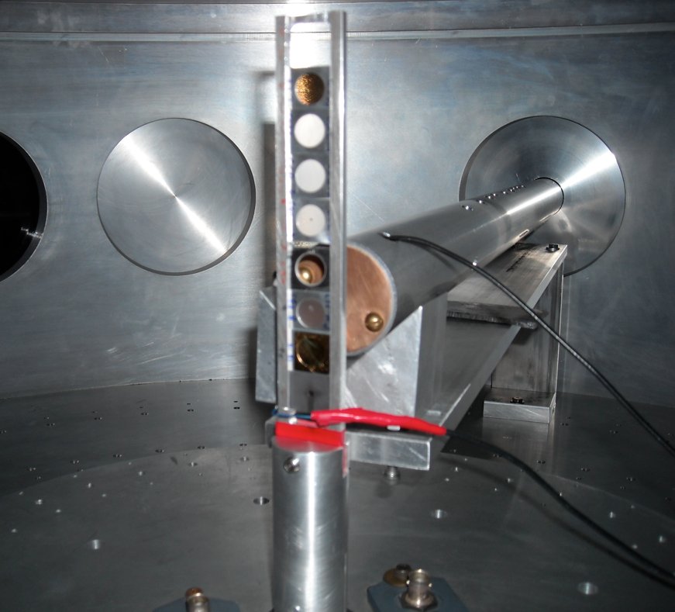
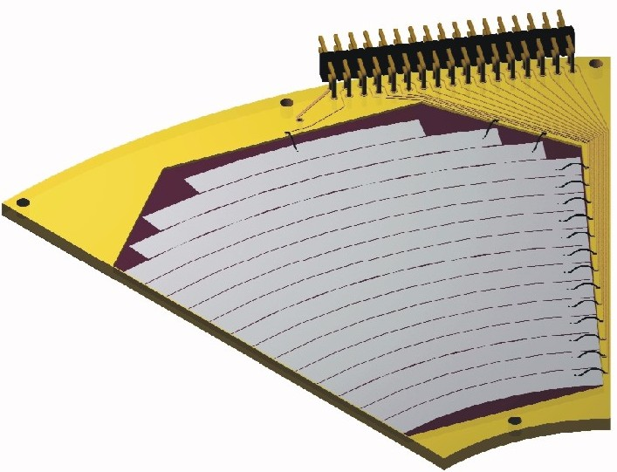
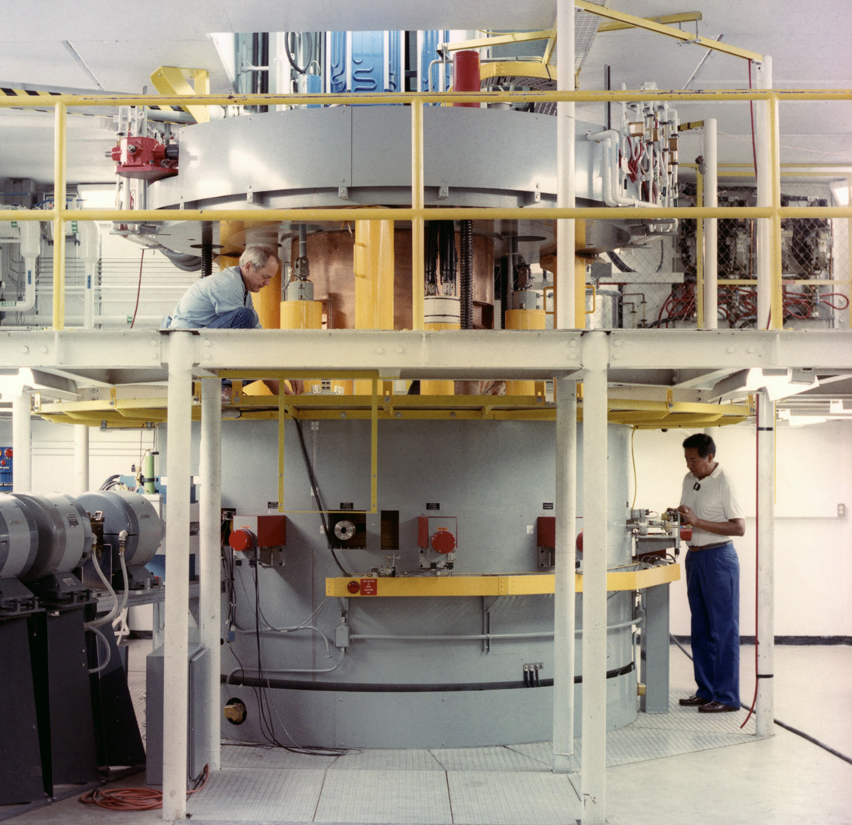
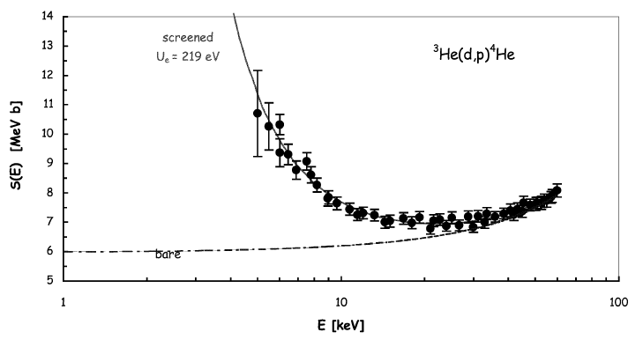

The need of indirect methods: direct vs. indirect methods
How to measure the A+x→c+C reaction in a direct way?
However, several reasons make the low-energy region of astrophysical interest difficult to access
Coulomb barrier suppression of the cross section
Cosmic background and systematic errors due to, e.g., straggling in the target
Electron screening hiding the nuclear cross section
Detector →
kinematic observables
- Energy
- Emission angle
& Particle identification
Target (A)
Beam (x)
Reaction
product (c)
It looks quite simple!

Slide 5
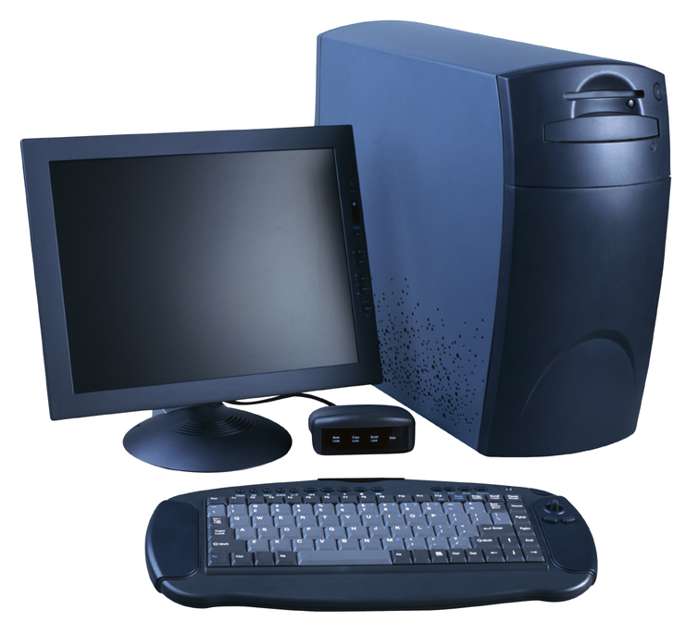
The need of indirect methods: direct vs. indirect methods
Nuclear reaction theory required
→ cross checks of the methods needed
→ possible spurious contribution
→ additional systematic errors (is the result model independent?)
Several reaction mechanisms link the two channels
Entrance channel:
A+a
Reaction products
C+c+…
Advantages include no need of low energies → no straggling, no Coulomb suppression, no electron screening
Possibility to access astrophysical energies with high accuracy
To recall the previous sketch:
Indirect methods are especially useful in the case of reactions involving radioactive nuclei
Higher cross sections
Possibility to study reactions induced by neutrons on radioactive nuclei
Reactions among unstable nuclei
Easier experimental procedures
Nuclear reaction theory
R. Tribble et al., Rep. Prog. Phys. 77 (2014) 106901

Slide 6
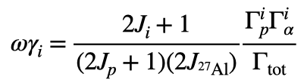
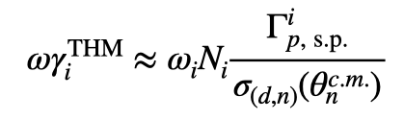
The method (see PRL 101, 152501 (2008))
²H
n
When narrow resonances dominate the S-factor the reaction rate can be calculated by means of the resonance strengths and resonance energies only. Both can be deduced from the THM cross section.
Let’s focus on resonance strengths
p
⁴He
²⁷Al
The strengths are calculated from resonance partial widths
In the THM approach we determine the strength in arb.units. Normalization to a known resonance is necessary
²⁴Mg
What is its physical meaning?
Area of the Breit-Wigner describing the resonance
Advantage:
no need to know the resonance shape (moderate resolution necessary)

Slide 7
Data analysis 1: detector calibration
Energy calibration:
Alpha sources
²⁷Al scattering off Au
D recoil off ²⁷Al
¹²C recoil off ²⁷Al
²H(²⁷Al,𝛼)²⁵Mg rection
At beam energies from 40 to 80 MeV
Position calibration:
𝝑-𝝓 vs. detector pixel correspondence was established using detector geometry and cross checked using ²⁷Al elastic scattering on gold

Slide 8
Data analysis 2: channel selection
Then the Qvalue spectrum is reconstructed
A=1 from the fit
First the mass of the undetected particle is deduced:
Y=E_{beam}-E_{A}-E_{C}
X=p_{A}²/2u
Two peaks for ²⁴Mg gs and 1st excited
Arrows: theoretical Qvalues

Slide 9
Data analysis 3: relative energy spectra
²⁴Mg-𝛼 relative energy → ²⁸Si excitation energies → This is the spectrum of astrophysical interest
²⁴Mg-n relative energy → ²⁵Mg excitation energies → background (sequential decay)
⁴He+n relative energy → ⁵He excitation energies → background (sequential decay)
d
𝛼
²⁹Si
²⁷Al
²⁵Mg
d
⁵He
²⁹Si
²⁷Al
²⁴Mg

Slide 10
Data analysis 4: selection of QF process
²H
n
B-D
A-C + B-D
p
⁴He
²⁷Al
²⁴Mg
When the breakup is quasi-free, n retains the same momentum as inside d (adiabatic process). So n-momentum distribution should be the same as in d
We gate on a 50 keV energy window to keep the cross section constant
The red curve is the theoretical one: normalization is the only fitting parameter

Slide 11

Center-of-mass energy spectra
For the analysis cuts we deduce the E_{cm} spectra from the standard formula:
Only free parameters: resonances relative heights
A-C
Black points: QF reaction yield corrected for phase space effects for THM data
Red line: simulated QF reaction yield corrected for space effects:
- All experimental effect accounted for (pixel size, energy resolution beam, …)
B-D

Slide 12
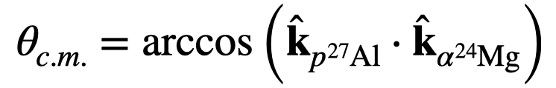
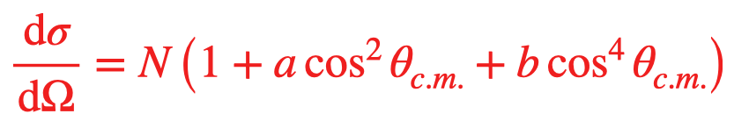
Angular distributions
Angular distributions for each peak in the E_{cm} spectra [(a)-(e) in order of increasing energy] were deduced
Each peak is the superposition of many resonances, so only the dominant wave can be deduced
A-B & C-D show the same trend
The region around 𝝿/2 is covered, which is the most influential for angular integration
Red line:

Slide 13
Integrated THM cross sections
Integration over 𝝷_{c.m.} was carried out for the two couples of detectors separately, using the fitting curve in the previous slide
Uncertainties on the shape of the angular distributions beyond the fitting regions were taken into account, through the uncertainties affecting fitting parameter a and b
Uncertainties are larger for higher energies
For the two couples, independent analyses were carried out, compatible results → low systematic erros

Slide 14
Extraction of the resonance strengths
Gamow window for 50 MK
Black dots: sum over the two spectra for A-C and B-D
Following discussion in APJ 708 (2010) 796 the red line is a fit with a sum of Gaussian functions, with fixed energies and fixed widths (from MC). Heights are proportional to strengths
The most intense resonances in STARLIB were all included in the fit down to about 200 keV
Tails of higher energy resonances affects the region above 1.5 MeV

Slide 15
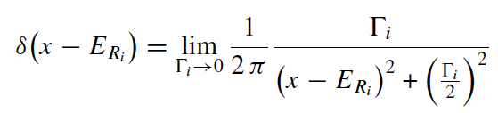
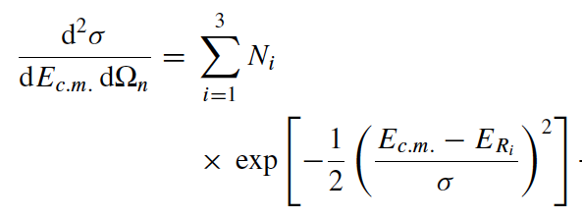
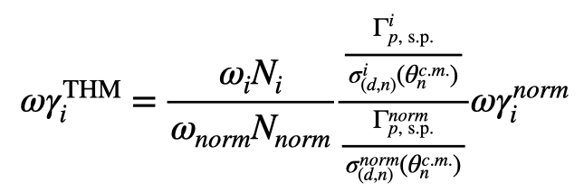
A bit of theory (from APJ 708 (2010) 796)
For narrow resonances:
The THM cross section can be fitted using the equation:
𝞒_{s.p.} is calculated using the potential model
𝞼(𝞱) is calculated in PW using the same well & w.f.
n
The double ratio ensures an extra small model dependence (6%)

Slide 16
Tabulated strengths: THM vs. STARLIB
Energy in cm (keV) [from STARLIB] | Jpi | Strength (eV) [from STARLIB] | error (eV) | Strength (eV) [from THM] | error (eV)
71.5 | 2+ | 2.47E-14 | up lim | 9.28E-15 | up lim
84.3 | 1- | 2.60E-13 | up lim | 1.90E-14 | 4.7E-15
193.5 | 2+ | 3.74E-07 | up lim | 2.82E-07 | up lim
214.7 | 3- | 1.13E-07 | up lim | 4.92E-08 | up lim
486.74 | 2+ | 0.11 | 0.05 | 0.122 | 0.031
609.49 | 3- | 0.275 | 0.069 | 0.282 | 0.082
705.08 | 1- | 0.52 | 0.13 | 0.30 | 0.10
855.85 | 3- | 0.83 | 0.21 | 0.71 | 0.56
903.54 | 3- | 4.3 | 0.4 | 4.3 | 0.4 | normalization value
1140.88 | 2+ | 79 | 27 | 83 | 21
1316.7 | 2+ | 137 | 47 | 142 | 43
1388.8 | 1- | 54 | 15 | 70 | 18
In general, good agreement between THM and STARLIB
Validation of the method and new results/better upper limits below about 200 keV
Since the two states around 200 keV cannot be resolved, a conservative limit is obtained attributing the whole THM strength to both resonances. This is because they have different l so the effect OES is different

Slide 17
Normalization test using a higher energy resonance
Energy in cm (keV) [from STARLIB] | Jpi | Strength (eV) [from STARLIB] | error (eV) | Strength (eV) [from THM] | error (eV)
71.5 | 2+ | 2.47E-14 | up lim | 7.17E-15 | up lim
84.3 | 1- | 2.60E-13 | up lim | 1.47E-14 | 4.3E-15
193.5 | 2+ | 3.74E-07 | up lim | 2.18E-07 | up lim
214.7 | 3- | 1.13E-07 | up lim | 3.80E-08 | up lim
486.74 | 2+ | 0.11 | 0.05 | 0.094 | 0.028
609.49 | 3- | 0.275 | 0.069 | 0.218 | 0.071
705.08 | 1- | 0.52 | 0.13 | 0.232 | 0.086
855.85 | 3- | 0.83 | 0.21 | 0.55 | 0.44
903.54 | 3- | 4.3 | 0.4 | 3.3 | 1.2
1140.88 | 2+ | 79 | 27 | 64 | 19
1316.7 | 2+ | 137 | 47 | 110 | 37
1388.8 | 1- | 54 | 15 | 54 | 15 | normalization value
In general, normalizing to 1.4 MeV resonance leads to a little smaller resonance strengths than before, still in agreement with STARLIB values

Slide 18
Average values
Energy in cm (keV) [from STARLIB] | Jpi | Strength (eV) [from STARLIB] | error (eV) | Strength (eV) [from THM] | error (eV)
71.5 | 2+ | 2.47E-14 | up lim | 8.23E-15 | up lim
84.3 | 1- | 2.60E-13 | up lim | 1.67E-14 | 3.2E-15
193.5 | 2+ | 3.74E-07 | up lim | 2.50E-07 | up lim
214.7 | 3- | 1.13E-07 | up lim | 4.36E-08 | up lim
486.74 | 2+ | 0.11 | 0.05 | 0.107 | 0.021
609.49 | 3- | 0.275 | 0.069 | 0.245 | 0.054
705.08 | 1- | 0.52 | 0.13 | 0.261 | 0.065
855.85 | 3- | 0.83 | 0.21 | 0.61 | 0.35
903.54 | 3- | 4.3 | 0.4 | 4.20 | 0.38
1140.88 | 2+ | 79 | 27 | 73 | 14
1316.7 | 2+ | 137 | 47 | 124 | 28
1388.8 | 1- | 54 | 15 | 61 | 12
We take the weighted average of the strengths obtained from the two normalizations procedure to reduce systematics errors

Slide 19
The full calculation using STARLIB (by Philip Adsley)
The green line is the THM recommended rate
We run the full code (for STARLIB and STARLIB+THM replacing our results in the standard input)
Is the upper limit for the resonance at about 200 keV overestimated?

Slide 20
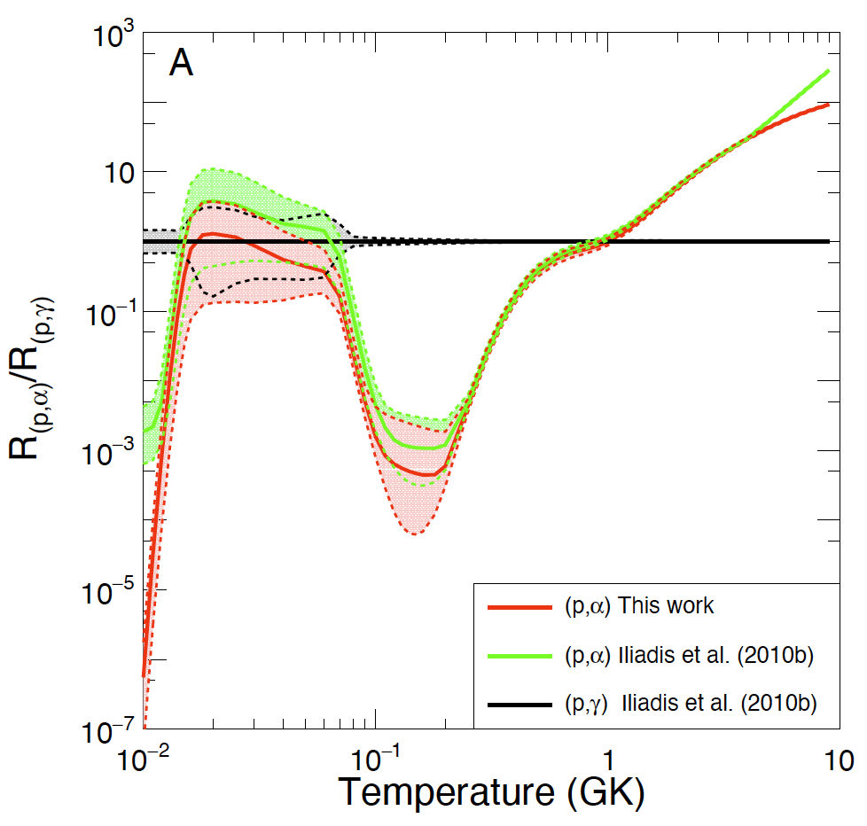
Some astrophysical consequences 1
Closure of the MgAl cycle
→ THM data seem to strengthen the fact that no closure of the cycle is to be expected, but uncertainties are large
More work necessary
Need of more accurate p,γ S-factor

Slide 21
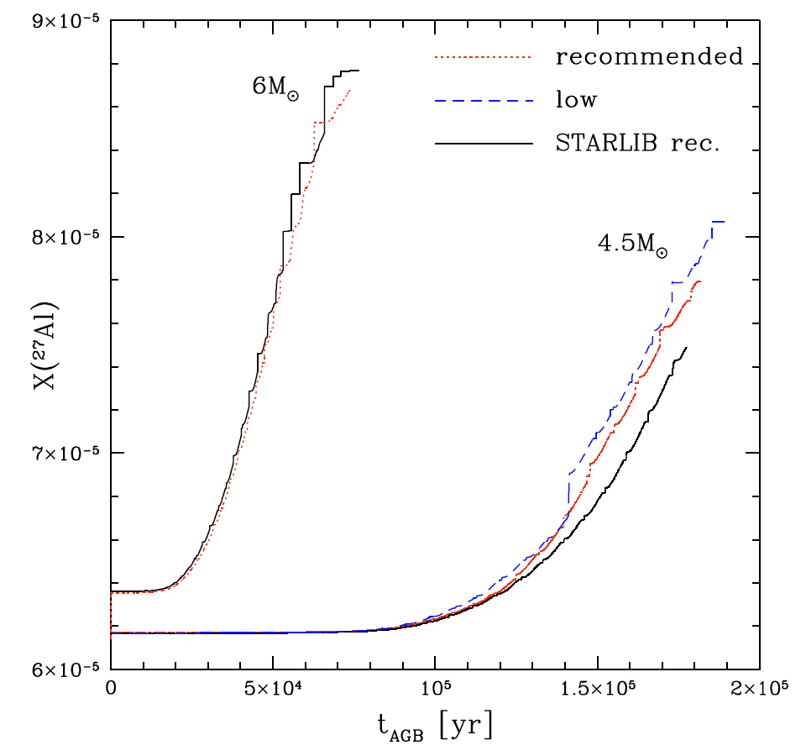
Some astrophysical consequences 2
We inspect the AGB evolution of intermediate mass stars at solar metallicity (Z=0.014) computed with the stellar evolution code ATON. We select the 4.5 M_{sun} (mild HBB) and 6 M_{sun} (strong HBB)
Negligible differences are found for 6M_{sun}: the temperatures at the base of the envelope are so hot (>80 MK) that the ²⁷Al(p,γ)²⁸Si channel is dominant
For 4.5M_{sun} we find a 5% increase in the surface 27Al when the new rates for ²⁷Al(p,α)²⁴Mg are adopted, a difference that rises to 25% when the lower limits are used.

Slide 22
Concluding remarks
Right after the lockdown, we managed to mount, run and complete a full experiment with no covid-19 cases
The experiment and the analysis were unexpectedly smooth, the analysis quick and standard
We could explore the whole energy region of astrophysical interest for the alpha 0 channel. For alpha 1 it is possible, but statistics is low
We could extract the strength of the 84 keV resonance and set more stringent upper limits
The calculated rate is about 3 times lower at astrophysically relevant temperatures than presently assumed

Slide 23


Thanks to:
The director for authorizing the experiment
The technical staff of LNS
Philip Adsley for running STARLIB
Flavia Dell’Agli for the astrophysical models
The team:
S. Palmerini et al. Eur. Phys. J. Plus (2021) 136: 898
M. La Cognata et al. Phys. Lett. B (2022) 826: 136917

Slide 24
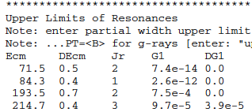
Extraction of the upper limits/1
Below 200 keV, our data are compatible with a single resonance centered at about 80 keV, with l=1
For the other resonances we can provide upper limits
Conservative upper limit: 36% fo the 84 keV resonance strength
Upper limit for the l=0 71.5 keV resonance is deduced from angular distributions

Slide 25
Extraction of the upper limits/2
Below 200 keV, our data are compatible with a single resonance centered at about 80 keV, with l=1
For the other resonances we can provide upper limits
For the states around 200 keV statistics is too low so the upper limits is deduced by shifting the peak by 1 energy bin and adding a Gaussian as large as possible

Slide 26
Calculation of the reaction rate: the poor man approach (for the norm.@903 keV)
By using Mathematica, I built a MC code to calculate the reaction rate taking lognormal distributions for the measured strengths, and Porter-Thomas distributions in the case only upper limits are available
The MC included only the resonances listed in the previous table
The given uncertainties are 1 sigma
Red: THM
Grey: STARLIB
Temperatures of interest for massive stars hydrostatic H-burning

